Slide 1

AI/ML applications use cases
Client conversion in retail business

Slide 2
Agenda
Facts on data driven marketing
Direct marketing and AI/ML applications
Use cases

Slide 3
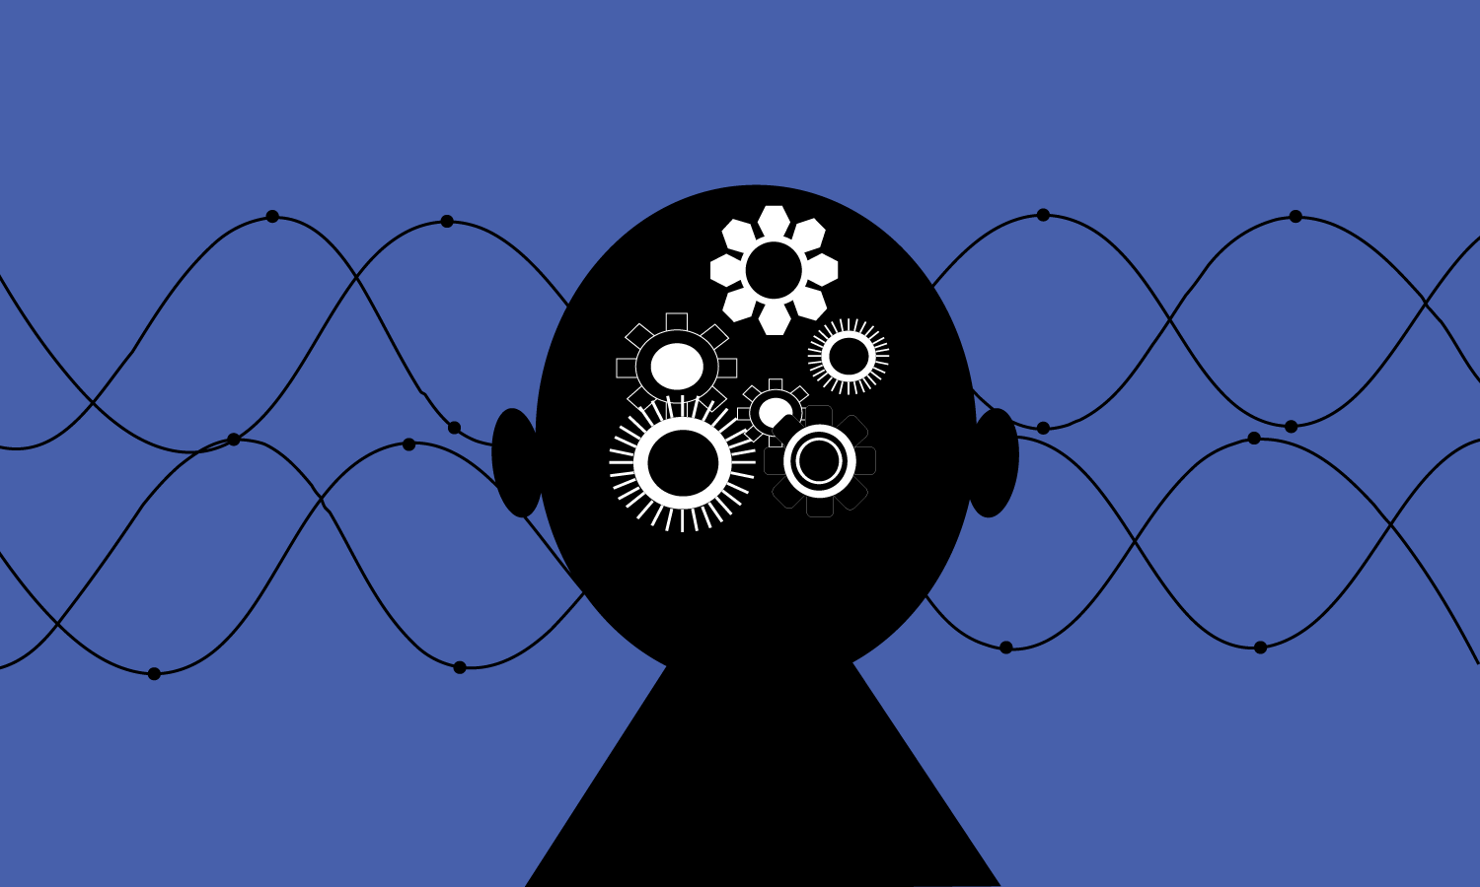
Facts on data driven marketing
In dynamic demand patterns, sales forecast mostly fails.
Customer data driven demand forecast is the key to sales efficiency.
“Only 28.1% of closed deals are predicted accurately 90 days out, and the actual close amounts differ by 31% from forecasts”, XANT Labs, Oct. 2019.
“We found that while 74% of firms say they want to be “data-driven,” only 29% say they are good at connecting analytics to action. That is the problem.” – Forrester research, March 2016

Slide 4

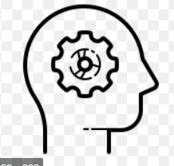
Direct marketing and AI/ML
Tested and analysed results
New business opportunities
Increased sales
Optimized marketing budget
Upgraded loyalty strategies
Direct campaign client interaction data.
Segmentation and targeting using ML

Slide 5
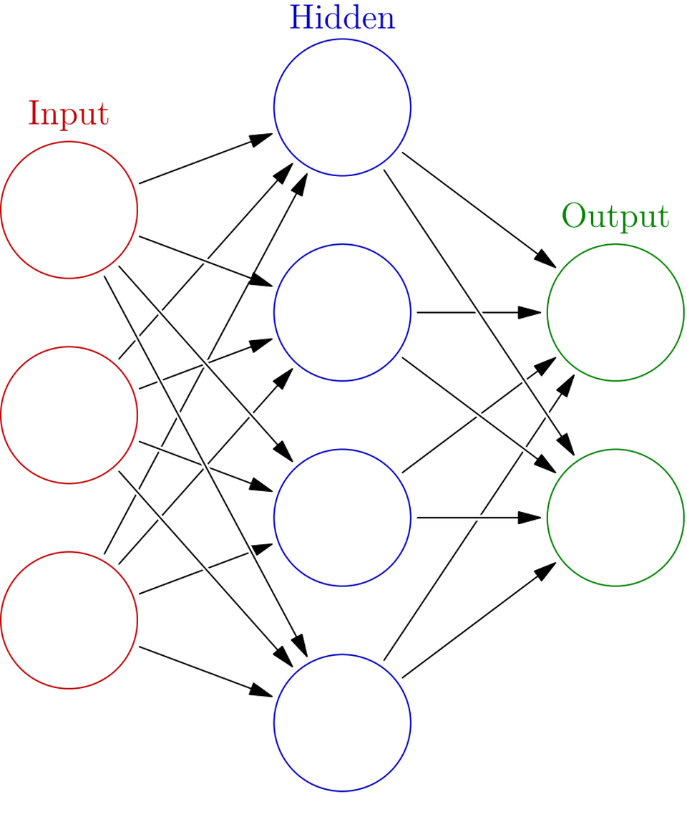
Use case
Previous direct campaign customer data.
Perform exploratory data analysis to identify interdependencies of features.
Develop a classification model to predict conversion of a client to subscribe to the product.
Data:
xyz Company direct marketing campaign data

